Slide 1
History of NASH
By Steve Waldstein RSHom(NA) CCH PCH

Slide 2
NASH
Started in 1990 by Lou Klein, Eric Sommer & Val Ohanian
Original purposes:
Set standards of competency
Certify homeopaths
Advocate for legality
Develop national recognition for homeopathy
Gain acceptance for professional homeopaths in the homeopathic community

Slide 3
NASH- Set Standards for Homeopathy
We set minimum requirements- including number of hours of instruction- which had to be at one of the good in person schools, and been in practice long enough to have good cured cases to submit.
We focused mainly on the ability to take and solve cases
We found that many people went to homeopathic schools but could not take a full case or solve the case in a way that showed good grasp of homeopathic principles
We did not require an exam

Slide 4
NASH- CHC
The CHC – Council for Homeopathic Certification started one year after NASH
They had a different view on how to test competency.
We felt that using their exam was a worthwhile approach to not have to do one ourselves. It also helped address the dual nature of NASH- both a examining board and a professional association protecting the rights of professional homeopaths.
While NASH focused on professional homeopaths- not licensed in another medical field- the CHC focused on everyone
While NASH had many focuses, of which certification was just one, the CHC’s only purpose was certification

Slide 5
NASH – CHC Getting Closer
From the beginning the CHC and NASH talked a lot, we placed a member on their board of directors and we tried to see how we could work together
After years of trust-building we reached an agreement to work together
We got the CHC to raise their standards- requiring more cases
We got the CHC to grandfather in all RSHom’s- giving them all a CHC without taking the exam- this was very difficult to get them to agree to
We put our Registrar into a key position at CHC- keeping the standards high

Slide 6
NASH- CHC Relationship
Using the CHC to do the certification to our standards fulfilled both the original purposes of Setting Standards for Competency and Certification of Homeopaths
In 2001 we completed the agreement for a joint relationship with the CHC.

Slide 7
NASH- Advocate for Legalization
Long Term Plans
Discussions with attorneys of best ways to approach legalization
Decisions to Focus More on Health Freedom Approach Not Licensure
Focus on Setting Standards Within the Profession So That the Government Would Stay Away
Testify FDA
Contributed Money and Energy to Health Freedom Campaigns
Established Legal Defense Fund and Aided With Both Money and Advice When RSHom’s got into legal trouble for practicing homeopathy

Slide 8
NASH- Develop National Recognition for Homeopathy
The least developed of the original goals
We tended to leave this more to the NCH

Slide 9
NASH-Gain Acceptance for Professional Homeopaths in the Homeopathic Community
Our Most Challenging Goal and Most Successful
In 1990 when NASH Started professional homeopaths not allowed to attend most homeopathic seminars, not allowed to any role in NCH, treated as third class citizens
By 2003 by NASH refusing to accept this position and insisting on a place at the table- professional homeopaths were fully accepted everywhere- we were a major part of all homeopathic institutions and were no longer made to sit in the back of the bus.

Slide 10
NASH- Presidents
1990- ? Lou Klein
? Eric Sommerman
? -1997 Val Ohanian
1998-2000 Miranda Castro (after 2 years as Exec. Dir)
2000-2003 Steve Waldstein
2004-2004 Sadhna Thakkar
2005-2015 Manfred Mueller
2016- Tanya Kell

Slide 11
NASH- Other Projects
Quarterly Newsletters
The American Homeopath yearly journal
Annual Conferences

Slide 12
NASH- The American Homeopath
In 1994- Greg Bedayn asked Lou Klein permission to start a homeopathic journal for NASH
He felt the current US homeopathic journals were not at a high enough standard and he proposed an annual high quality journal for strictly classical homeopathy
Greg did all the work himself including finding artists to paint paintings for the cover.

Slide 13
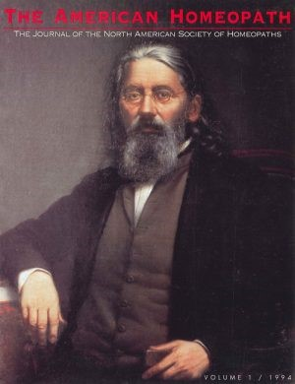
Volume 1 1994 Constantine Hering

Slide 14
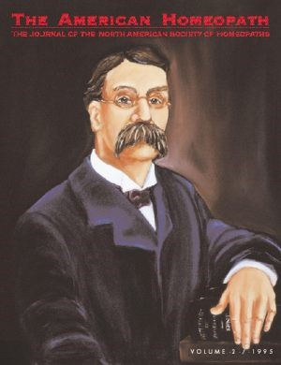
Vol 2 1995 James Tyler Kent

Slide 15
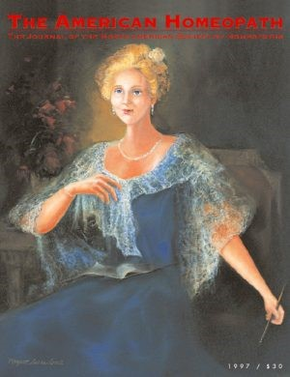
Vol 3 1996 Melanie Hahnemann

Slide 16
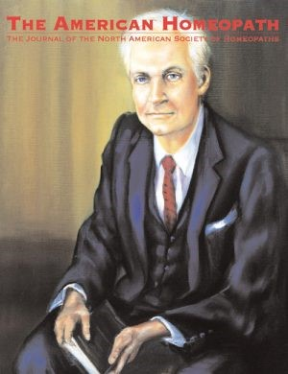
Vol 4 1997 Harris Coulter

Slide 17
NASH- The American Homeopath
Named after a journal from 1879 The American Homeopath, which had a motto “Hew to the line, let the chips fall where they may.
When Greg felt that the community was drifting away from pure homeopathy he wrote an excellent Editorial Titled “Hew to the Line” calling people back to real homeopathy.
Greg died in 2008 at the age of 58. When he got sick he passed on the work to others
The journal is now 23 years old- a testament to what Greg and NASH started

Slide 18
NASH Conferences
To help build a community of professional homeopaths- at a time when we were not very welcome elsewhere we started an annual conference – set to a high standard
These were from 1999-2004 when we combined the conference with the NCH

Slide 19
NASH- Annual Conferences
New York City 1998
  Keynotes:
Vancouver 1999
  Keynotes: Lou Klein & Alize Timmerman
New York City 2000
  Keynotes: Jeremy Sherr, Andre Saine & Paul Herscu

Slide 20
NASH- Annual Conferences
Copper Mountain, Colorado 2001
  Keynotes: Jan Scholten & Mischa Norland
Deerfield Beach, Florida 2003
  Keynotes: Nandita Shah & Janet Snowden

Slide 21
NASH- Society of Homeopaths UK
When NASH was being conceived- the best model seemed to be the Society of Homeopaths in the United Kingdom
We informally discussed what they thought of us modeling on them and got positive feedback but I don’t think there was any formal agreement
Since the Society of Homeopaths gave a RSHom registration- Registed Society of Homeopaths NASH decided on a US+ Canada equivalent of RSHom(NA)
All homeopathic organizations in the world know and recognize the RSHom (NA). No countries officially recognize it.

Slide 22
NASH- The Future
When I left the helm at NASH our relations with the CHC was excellent, we had met our original goals, but financially we were in bad shape.
The new board cut costs by making the quarterly newsletter email only- something we wanted to do but had too much backlash from a minority of members who were not computer savy. The piggybacking on the NCH conference also saved a lot of money. Also eliminating the portraits for the American Homeopath.
Financially things improved greatly but the relationships with the rest of the community which we carefully maintained were allowed to decline.

Slide 23
NASH- The Future
Now that the CHC has lowered standards and NASH rightfully had to step up and not allow the standards to be lowered – the careful balancing act that we did to maintain a united community is being lost.
It is important that NASH learn to form bridges to all the other homeopathic organizations- pressuring them to maintain proper standards and build a united future.
We need to continue to keep the government from interfering with the practice of homeopathy, something the early NASH Board worried about and took steps to try to avoid.

