Slide 1

Welcome to NASH’s 2018 Annual Member Meeting

Slide 2

Board of Directors
NASH President - Tanya Kell, RSHom (NA) – tanya@homeopathytennessee.com
Vice President – Robert Field, CCH, RSHom(NA) – robertfieldhomeopath@hotmail.com
Treasurer – Julie Mann, CCH, RSHom(NA) – ma13nn@aol.com
Secretary – Anna Cox, CCH, RSHom(NA) – anna4homeopathy@me.com
Registrar – Laura Sholtz, CCH, RSHom(NA) – choosehealth@tds.net
Board Member – Myra Nissen, CCH, RSHom(NA) – myra@myranissen.com
Binational Liaison – Lorne Moyer, HOM – lornemoyer@gmail.com
Executive Director – Carleen Johnson, CCH, RSHom(NA) – nashinfo@homeopathy.org
Editor – Deborah Hayes, CCH, RSHom(NA) – editor@americanhomeopath.com

Slide 3
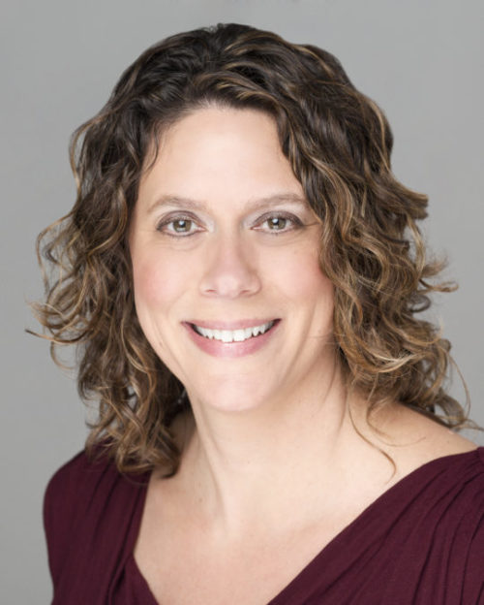


Tanya Kell, RSHom(NA)
President’s Address 2018
Bringing Homeopathy to the Podium through Advocacy

Slide 4

Tanya Kell, RSHom(NA)
Nash Activity:
Involvement in fundraising for homeopathic advocacy.
Nash contributes to the Health Freedom Coalition and the NEW – Super Smart Pack
Continued involvement advancing the homeopathic agenda in coordination with volunteers from HNA, AIH, AAHP, ACHENA, CCH and others!
Continued efforts to provide the public with access to the highest quality
Practitioners and Competency based vetting
Dedication to classical homeopathy
Kicking off the School Year with renewed connections to schools and students!!
Bringing Homeopathy to the Podium through Advocacy

Slide 5






Tanya Kell, RSHom(NA)
Super SMART PAC /
Centralizing Efforts:

Slide 6



Tanya Kell, RSHom(NA)
Working through HOMEOPATHS WITHOUT BORDERS

Slide 7
Tanya Kell, RSHom(NA)
President
Notes:
Competency Review Process
Results of Survey
Reflect on how membership feels

Slide 8
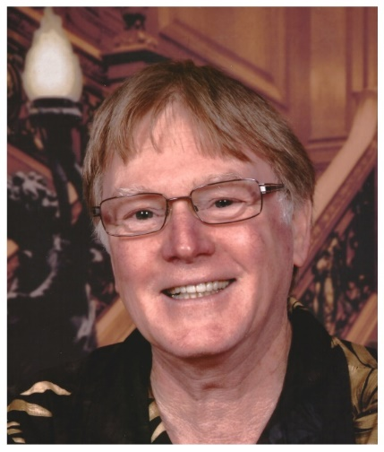
Bi-National Report
Canada / USA
Lorne Moyer
Bi-National Liaison to NASH
The Ontario Regulatory committee {College of Homeopaths of Ontario} raised its professional rate approximately three hundred dollars in the spring of the year and had a marginal loss of members.
The Canadian Association of Homeopaths “CAH” is still moving ahead with making themselves a legal national representative of all Canadian Homeopaths. There is no available information to say how they are doing, but last I heard they were moving ahead with becoming a non profit organization.

Slide 9

Bi-National Report
Lorne Moyer
Bi-National Liaison to NASH
The College of Homeopaths of Ontario has changed the rules involving RHPA on sexual abuse (Registered Health Professionals Act of Ontario). Giving exact definition of patient for the purposes of sexual abuse as specified.
The treating of a homeopaths spouse even if there is a pre-existing spousal relationship prior to treatment, it is irrelevant that patient has consented to treatment as it will still be looked upon as sexual abuse if the homeopath is engaged in the profession.
NOTE: The Ontario College of Homeopaths could create an exception, however at this point they have not done so!

Slide 10
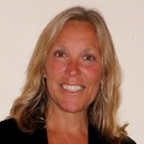
Julie Mann, RSHom(NA)
Treasurer’s Report
Review of 2017 Financial Report
    Finished the year with a total of $183,092
        NASH: $20,031
        Defense Fund: $125,337
        NASH Foundation: $37,723
    Where we are as of August 2018
        On budget
        Special Items

Slide 11

Julie Mann, RSHom(NA)
Director of the NASH Foundation
The NASH FOUNDATION was incorporated in Colorado in 1999 as a non profit charitable corporation dedicated to education, research and publications to support and enhance the profession of homeopathy. Activities of the organization include but are not limited to:
  Sponsoring workshops, seminars and conferences in homeopathic education
  Publishing educational and scientific materials relating to homeopathy
  Funding research projects involved with homeopathy
  Funding special projects that enhance and expand the awareness of the profession of homeopathy

Slide 12

Julie Mann, RSHom(NA)
Chair of Scholarship Committee
Carole Krones Scholarship
Priscilla Medders - $1,000 Nashville School of Homeopathy
David Malcolm Shein - $1,000 Academy of Homeopathy Education|NYC
Elizabeth Bonfig Scholarship
Amanda Ackerman - $1,000 -Los Angeles School of Homeopathy
Zoe Alexandra - $1,000 - Canadian College of Homeopathic Medicine
CONGRATULATIONS!!

Slide 13
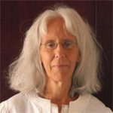
Registrar’s Report
      Laura Sholtz, CCH, RSHom(NA)

Slide 14

Registrar’s Report for 2017
Members by category in 2017 New Members by category in 2017
Schools – 11 Schools - 1
Students – 75 Students - 21
Associates – 102 Associates - 25
Registered - 223 Registered – 23
The 23 new Registered members in 2017 were eligible for Registered membership by:
CCH – 14
NASH Competency Review – 1
Reciprocal organizations – 8
2016 Figures for new members for comparison
Schools – 1
Students – 41
Associates – 15
Registered - 23

Slide 15


Laura Sholtz,
CCH, RSHom(NA)
Official
NASH
Book
Reviewer and
Editor

Slide 16
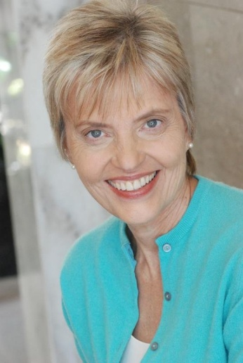
Myra Nissen, CCH, RSHom(NA)
  Membership Benefits Chair
  NASH Mentorship
  Program Student Liaison Program
  If you have any ideas for Webinars, send them to us!

Slide 17
Myra Nissen, CCH, RSHom(NA)
Board Member
Registered Member Benefits
• Receive the prestigious designation of RSHom (NA),
internationally respected title
• Individualized certificate of recognition
• Listing on NASH online Practitioner Directory
• Highly respected annual journal, The American
Homeopath
• Legal Shield and ID Shield Plans
• Professional Liability Insurance to Registered
Members with the option of adding General Liability
• Practitioner/Client Grievance procedure

Slide 18
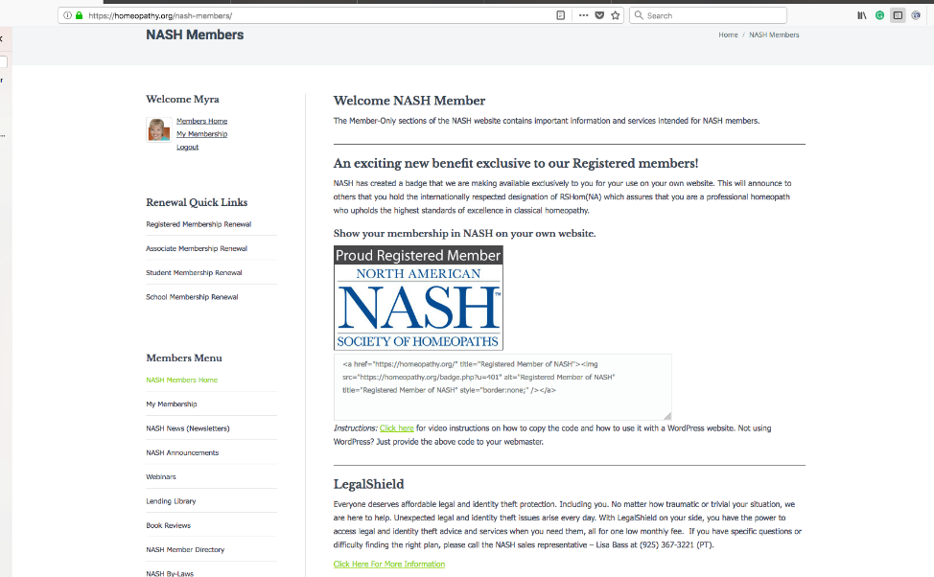
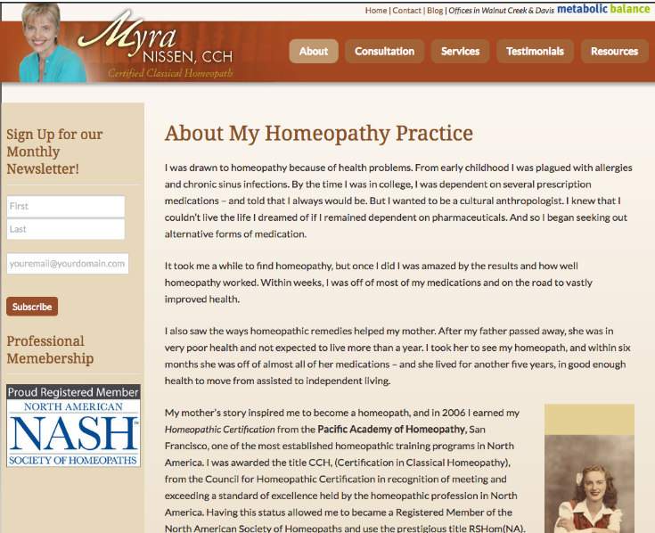
Myra Nissen, CCH, RSHom(NA)
Board Member
N
E
W
!
Registered Member Benefits (cont’d)
• NASH website badge for RSHom(NA)

Slide 19
Myra Nissen, CCH, RSHom(NA)
Board Member
For NASH RSHom(NA)’s -- CEU Reminder*:
20 hours of CEU’s per membership year
1. Attendance at a homeopathic conference or seminar – 1 hour equals 1 CEU
  a. Listening to recorded sessions such as those from the NASH’s Lending Library can comprise up to 5 of these CEU’s; a one page summary is required for each of those 1 hour recordings.
  b. For longer recorded courses (10 plus hours) a 2 page summary using our guideline will be required.
2. Postgraduate homeopathic training – 1 hour equals 1 CEU
3. Homeopathic teaching (at a school/college/conference) – 1 hour equals 4 CEU’s
4. Facilitating a study group – 1 hour equals 2 CEU’s
5. Supervising or mentoring a homeopath or homeopathic student – 1 hour equals 2 CEU’s
6. Published review (at least 400 words) of a homeopathic book/seminar etc. – equals 3 CEU’s
7. Published review (at least 800 words) of a homeopathic book/seminar etc. – equals 5 CEU’s
8. Published article in a professional journal (at least 3000 words) – equals 8 CEU’s
9. Published homeopathic book/manual – equals up to 20 CEU’s
10. Conducting or supervising a proving:
  a. The prover receives 5 CEU’s
  b. The supervisor receives 10 CEU’s
11. Homeopathic research – up to 20 CEU’s
12. Volunteering (such as for NASH) to enhance homeopathic education and outreach – 1 hour equals 1 CEU:
  a. Providing a NASH Telecast/Webinar – 1 hour telecast/webinar equals 2 CEU’s
  b. A maximum of 5 CEU’s will be granted for volunteering.
*NOT Necessarily CHC or ACHENA Approved

Slide 20
Myra Nissen, CCH, RSHom(NA)
Board Member
Associate Member Benefits
• State legislative support for the positive development of
homeopathy
• A voice solely representing the professional homeopath
• Members MP3 Library
• Volunteer & Networking opportunities
• Discounts on various homeopathic products through
selected companies
• Homeopathy Specific Informational Conference Calls/
Webinars
We are interested to hear what additional members benefits you would like NASH to offer.

Slide 21
Myra Nissen, CCH, RSHom(NA)
Board Member
Student Membership
Retired membership
Email nashinfo@homeopathy to apply
State/Province Association Membership
Journal Subscriptions
N
E
W
!
$40 for Associate membership (1/2 price!)
One complimentary journal annually for each member
N
E
W
!

Slide 22
Myra Nissen, CCH, RSHom(NA)
Board Member
School Membership
Academy of Homeopathy Education NYC/World
Baylight Center for Homeopathy
Caduceus Institute of Classical Homeopathy
Canadian College of Homeopathic Medicine
Homeopathic Academy of Southern California
The Homeopathic College
International School of Classical Homeopathy
Los Angeles School of Homeopathy
Nashville School of Homeopathy
New England School of Homeopathy
Northwestern Academy of Homeopathy
Resonance School of Homeopathy
School of Homeopathy

Slide 23
Myra Nissen, CCH, RSHom(NA)
Board Member
Student Liaison Committee
Mission: The Student Liaison Program will create a bridge between NASH and students of homeopathy.
Goal: To involve homeopathic schools as members of NASH, allowing their student representatives to dialogue with NASH and among themselves about issues affecting the homeopathic profession: Facebook group, incentive program.
N
E
W
!

Slide 24

Myra Nissen, CCH, RSHom(NA)
Board Member
Mentorship Program – under development
Goal:
Support Students and Associate Members earning their RSHom
Establish Mentorship Role for RSHoms
Mentorship Uniform Criteria through Certification
Income Opportunities for RSHoms
** Volunteers needed to help develop this program!**

Slide 25

Myra Nissen, CCH, RSHom(NA)
Board Member
Journal Project
• Journal Project is an opportunity to place our limited full sets of
journals at deserving libraries.
• Journals already placed:
- Southwest College of Naturopathic Medicine, Tempe, AZ, US (May
2017)
- Neiswander Library,King of Prussia, PA,US (May 2015)
- Helios Homeopathy, Ltd., Tunbridge Wells, UK (Feb. 10, 2015)
- REMEDIA Homöopathie, Eisenstadt, Austria (Dec. 2014)
- UCSF Library, San Francisco, CA, US (Sept. 2014)

Slide 26
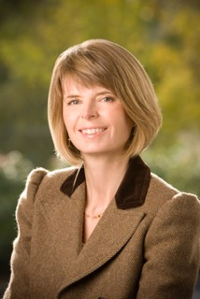
Deborah Hayes, CCH, RSHom(NA)
Editor of The American Homeopath
editor@americanhomeopath.com
Journal Report
Current issue of The American Homeopath (Volume 24)
Our next issue (Volume 25)
Some changes ahead
What do we need from members?

Slide 27
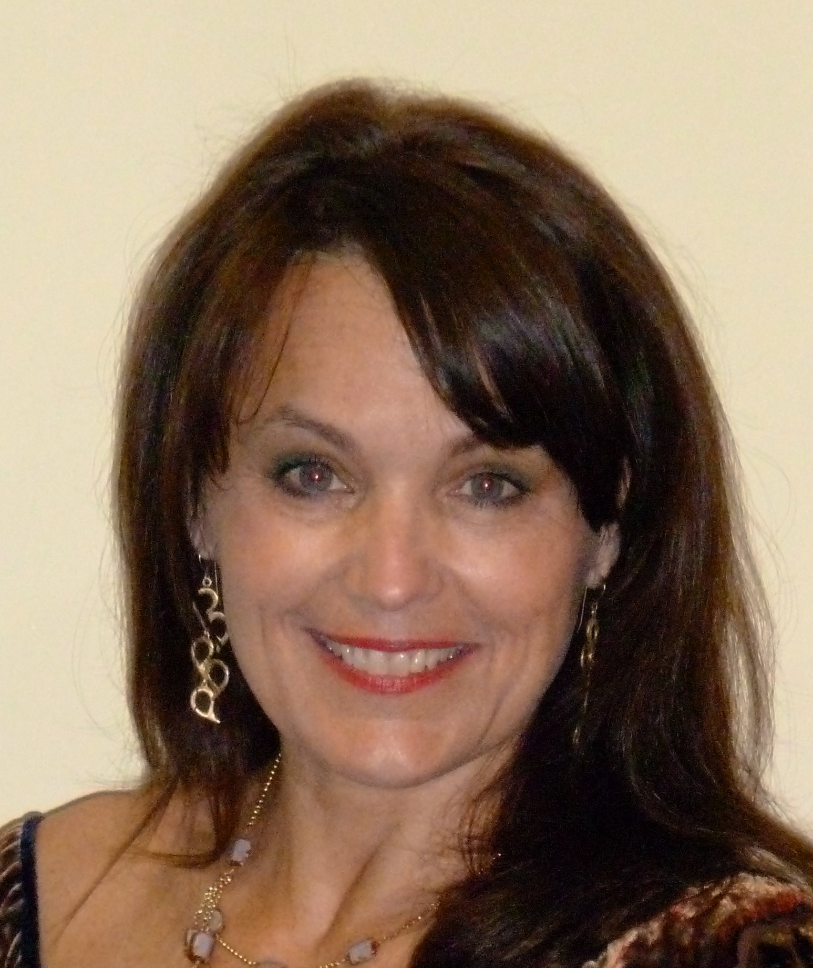
Health Freedom LEGISLATION
Anna Cox, CCH, RSHom(NA) Secretary
FDA -- Legislative up-datE
American Health Coalition
NASH
Health Freedom
Legislation
FDA Legislation
American Health Coalition

Slide 28
Health Freedom
Anna Cox, CCH, RSHom(NA)
Secretary
MISSION: Implementation of Safe Harbor Laws in EVERY STATE
NECESSARY ELEMENTS to accelerate this effort
An infusion of financial support
Lacked a program or platform to communicate with activists efficiently
Classical homeopaths unite with others desiring Safe Harbor Laws
NASH… THREE OBJECTIVES:
Facilitate NHFC/A fundraising efforts
Develop a program or platform to facilitate activists in every state
Support NASH Members in efforts to pass Safe Harbor Laws

Slide 29
Health Freedom
Still only 10 States with some form of SAFE HARBOR Legislation:
Anna Cox, CCH, RSHom(NA)
Secretary
anna4homeopathy@me.com
States with Health Freedom Laws:
1976 Idaho 54-1804
1994 Oklahoma Statute 59-480
1999 Minnesota Statute 146A
2001 California SB577
2003 Rhode Island Statute 23-75
2005 Louisiana Revised Statutes 20-37 VI-B
2008 Arizona Revised Statutes Sections 32-2911 Amended
2009 New Mexico Enacted the Unlicensed Health Care Practice Act
2013 Colorado Senate Bill 13-215

Slide 30

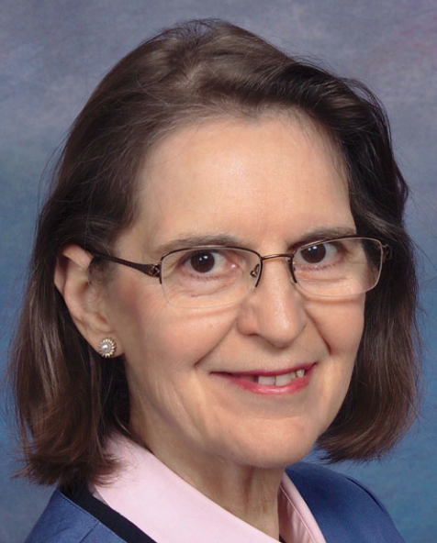
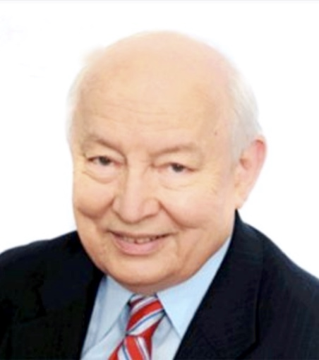
Health Freedom
Platform Creation…..A workspace for activists

Slide 31
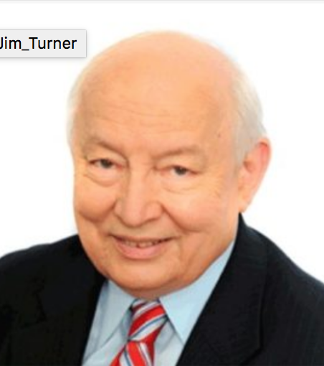
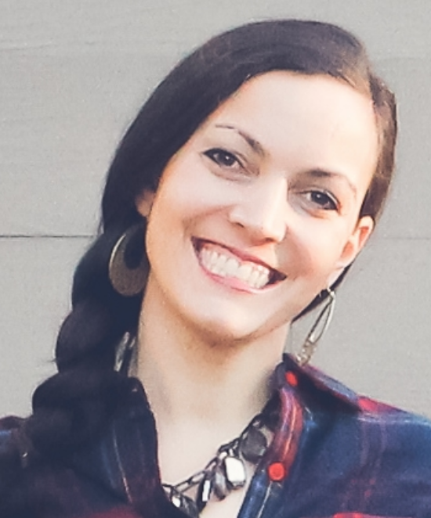


Legislative up-date
FDA Petition
VIEW CART0
https://homeopathychoice.org
Anna Cox, Secretary

Slide 32
Legislative up-date
FDA Petition
VIEW CART0
https://homeopathychoice.org
Keeping one step ahead!
Anna Cox, CCH,RSHom(NA)
Secretary
NASH Advocacy: What are YOU doing to advocate for Homeopathy?
What can NASH Members do collectively?
Media Response Teams: Professional and Consumer teams in every state. Training by Peter Gold and Americans for Homeopathy Choice PR Professional.
Evidence: American Institute of Homeopathy (AIH) Bound book to be submitted to FDA November 30th deadline.
Legislator Support: Americans for Homeopathy Choice has a reserved presentation room
on the Hill on April 10, 2019. To develop support, we need relationships with Representatives and Senators.
Can you be in D.C. to accompany your legislator to our presentation?

Slide 33
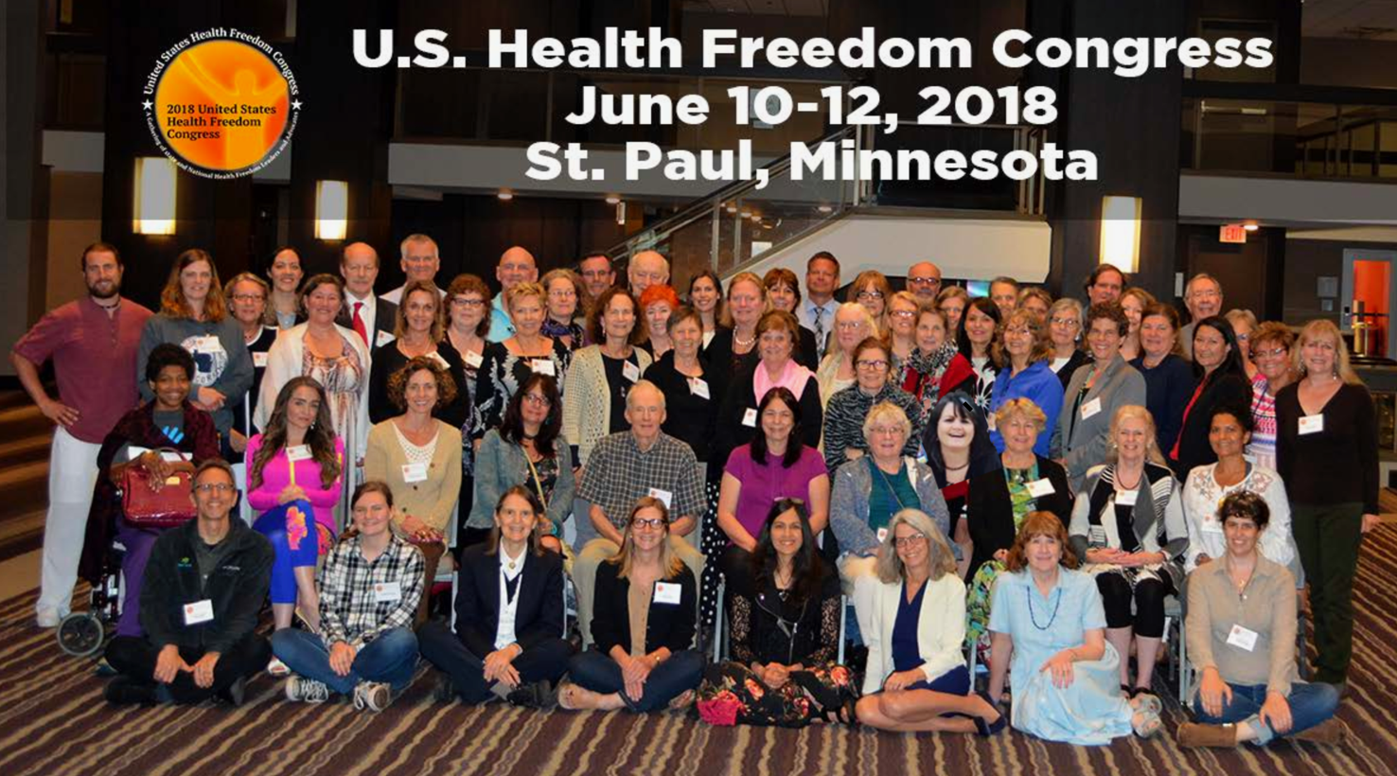
Health Freedom Coalition
US Health Freedom Congress
Anna Cox, CCH, RSHom(NA)
Secretary
Resolution:
Call for the Endorsement of
Model Legislation for
Safe Harbor Licensing
Exemption Law for
Traditional, Complementary
and Alternative Health
Care Practitioners.
https://healthfreedomcongress.com/

Slide 34

Health Freedom
Initiatives:
Anna Cox, CCH, RSHom(NA)
Secretary
NHFC/A: E-Book…
Soon to be on their website
Adding an Executive Director
Available to assist State initiatives
NASH: Collaborative Platform for Activism
…. Coming Soon!

Slide 35
“Volunteer---Appreciation”
The NASH Board would like to sincerely thank all of our volunteers, especially -
Arup Bhattacharya Deborah Landowne
Kate Birch Ilana Meyers
Tara Boyle Marci Mearns
Robin Daniel Linda Morse
Tarinder Dhingra Sudharani Raja Lyn Farrugia Delilah Raybee
Queenita Fernandes Judy Schriebman
Ephrem Gashaw Lauren Speeth
Marilyn Gerber Julee Stanley
Hasina Jahan Hai Sarah Thompson
Laurie Hoffman Sylviane Towne
Jenny Hwozdek Priya Varughese
Kip Krones Aaron Wolfe-Payton

Slide 36
We wish to thank you all for your attendance!

